Slide 1


Building Damage Assessment AI
Demir Bucukoglu
Cohort: James Tribble

Slide 2
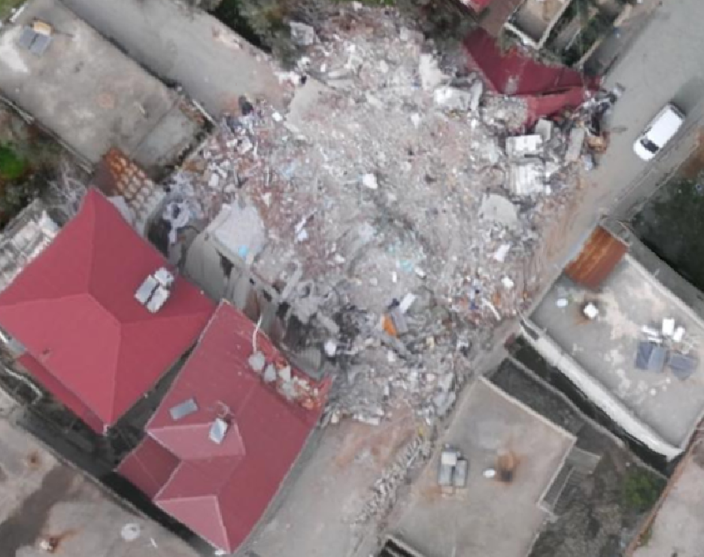
Description
I developed an object-detection AI that classifies buildings as damaged or undamaged following an earthquake, choosing this as my first AI project after building websites and game
After creating websites and games, I turned to AI, so I built an object-detection model that automatically identifies whether buildings are damaged or intact after an earthquake.

Slide 3
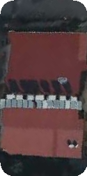
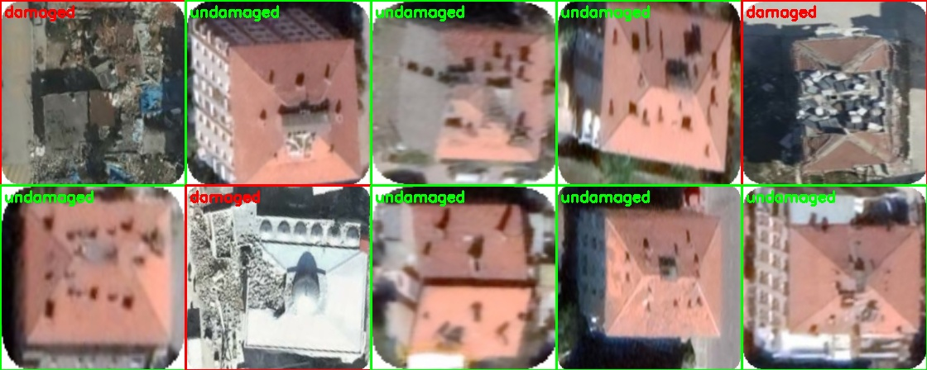
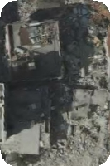
Methods
Image Classification
Trained ResNet-50 on 2,600 labeled images.
Achieved high accuracy distinguishing damaged vs. undamaged buildings.
Object Detection Patchwork 1.0 with Yolo V5
Adopted YOLOv5 for locating buildings in large scenes.
Developed a Python script to create randomized “patchwork” images by pasting building crops onto backgrounds.
Challenges
Model overfit to only 10 unique crops instead of generalizing.

Slide 4
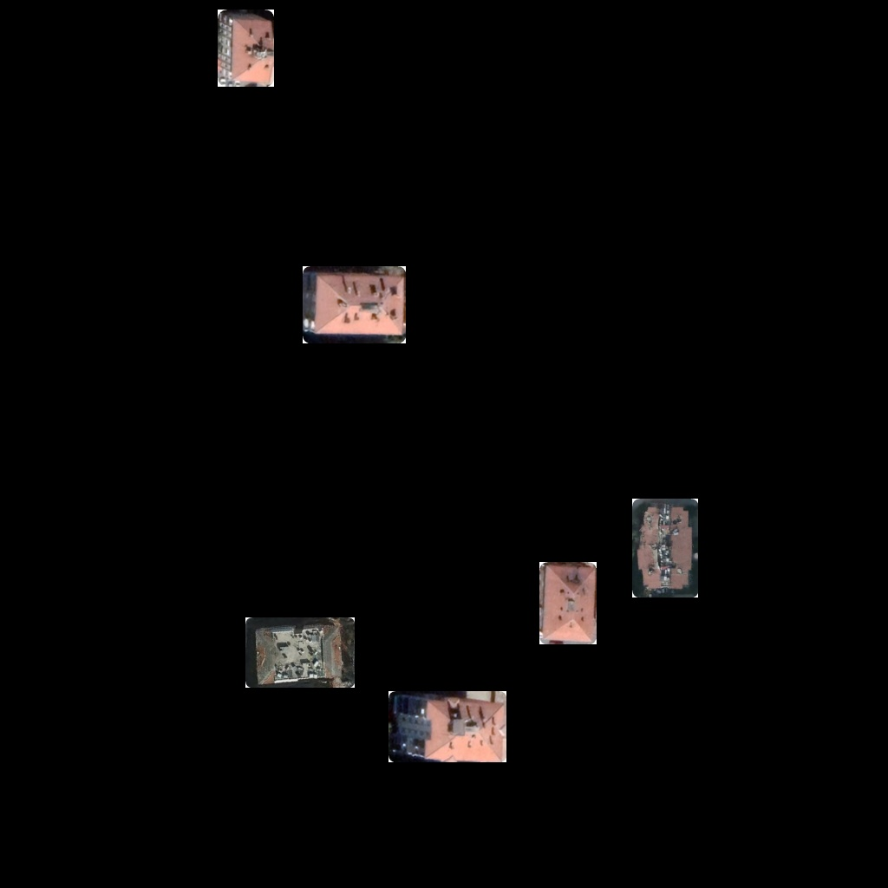
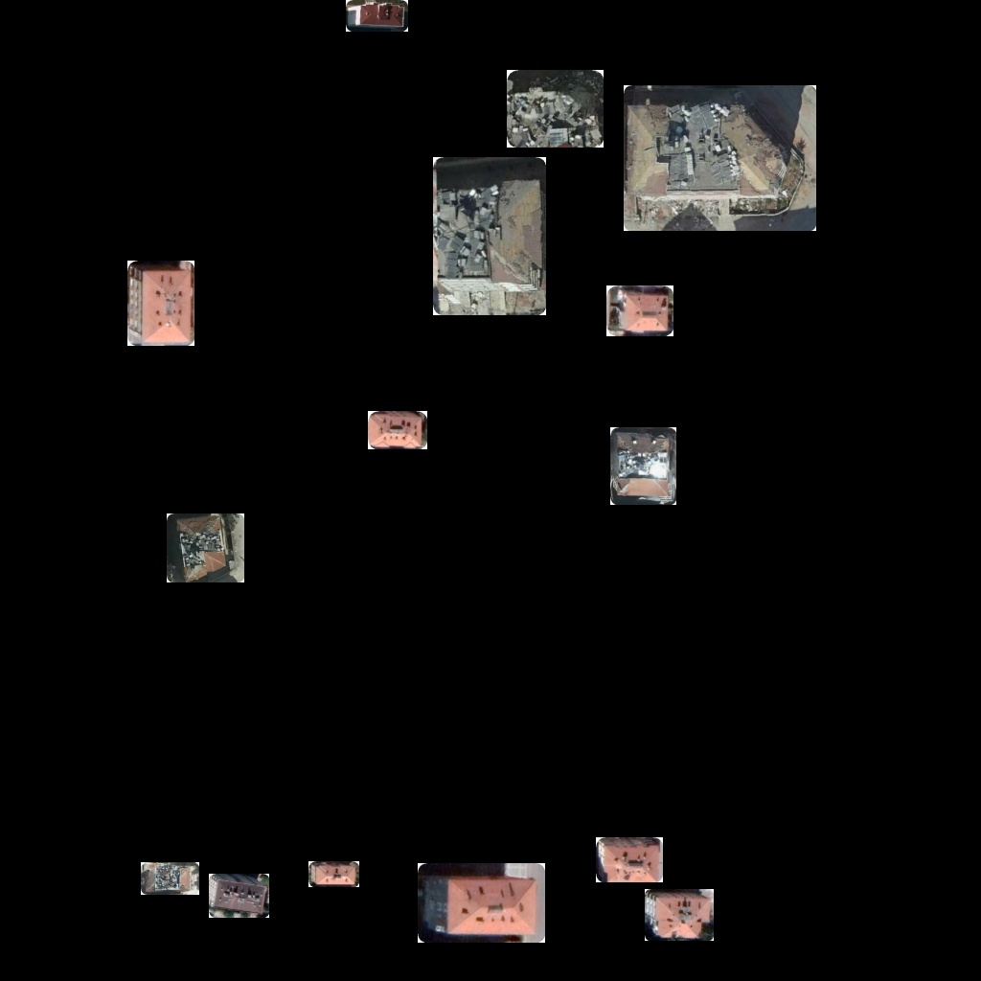
Object Detection with Yolo V5
Patchwork 2.0
Developed a Python script that pastes randomized building crops at varying scales onto black backgrounds to mimic real satellite imagery.
Created 2,500 training images.
Retrained YOLOv5 on this dataset.
Results
The updated detector now successfully (most of the time) locates and classifies both damaged and undamaged buildings in realistic scenes.

Slide 5
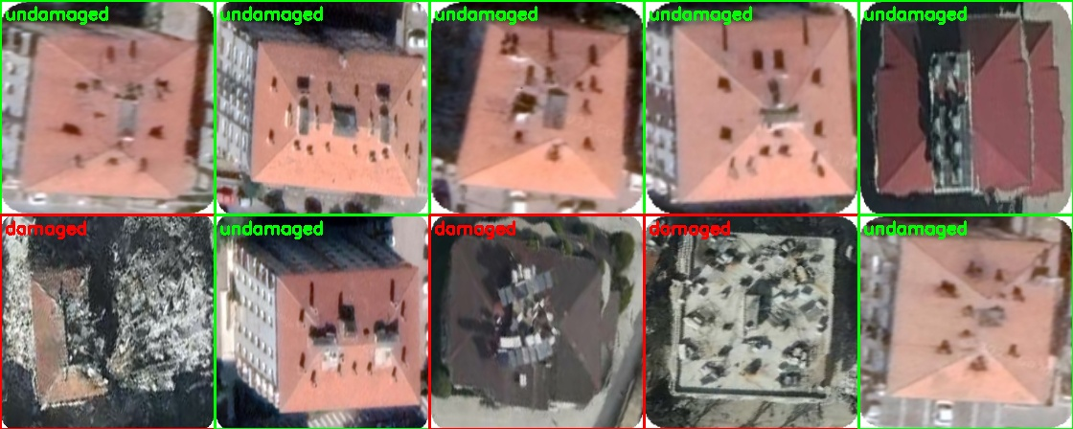
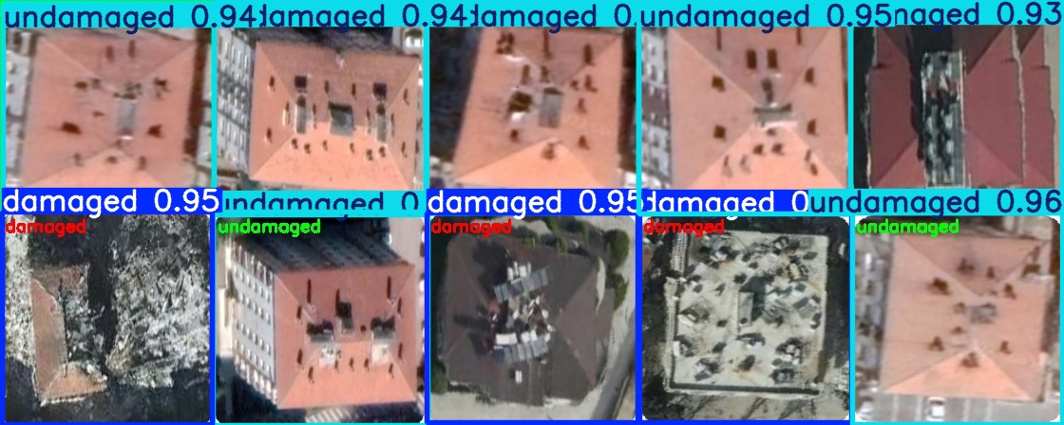
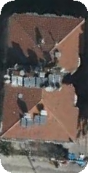
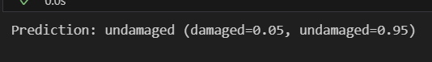
Progress
Actual Image
AI’s guess

Slide 6
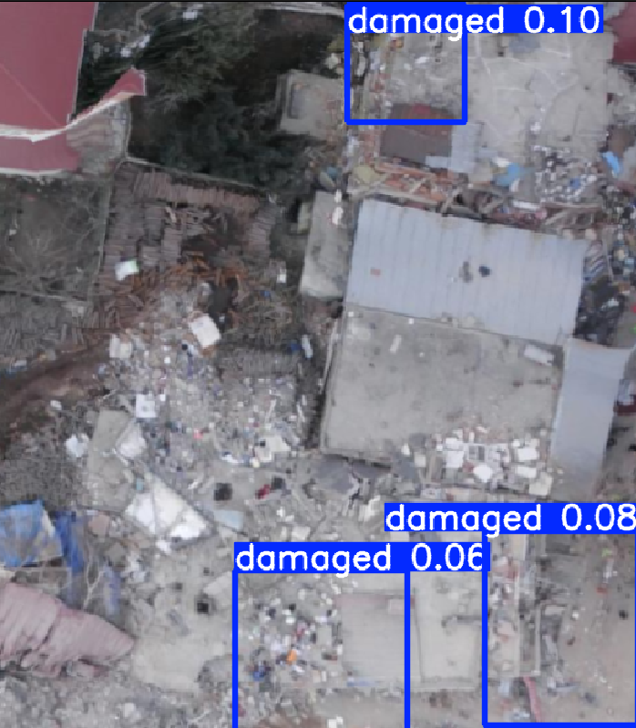
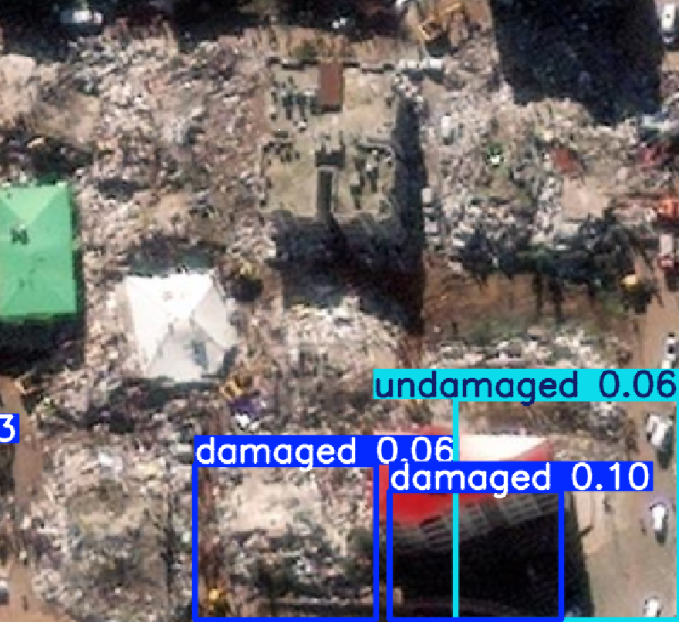
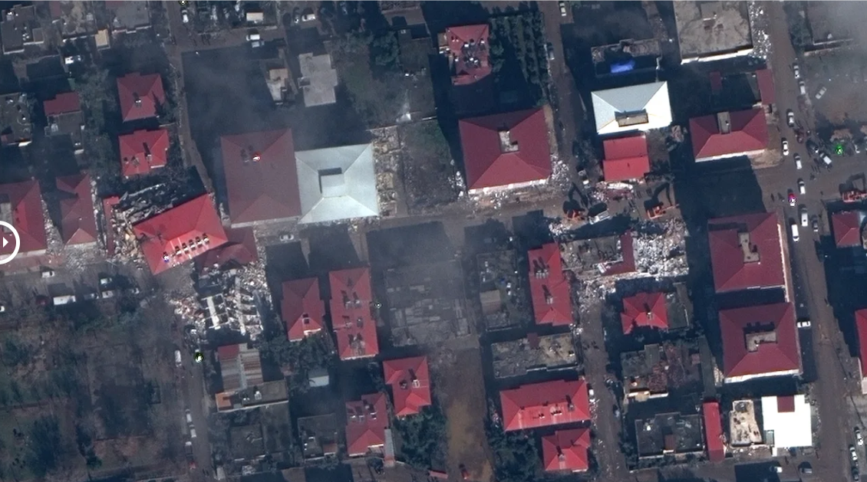
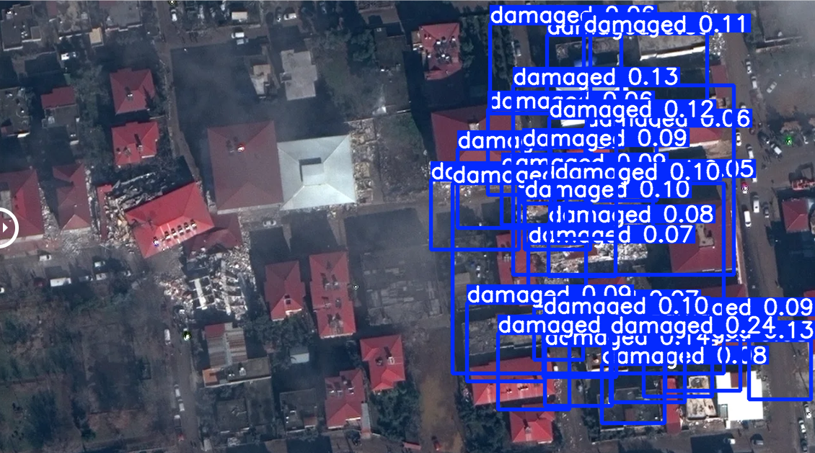
Results

Slide 7
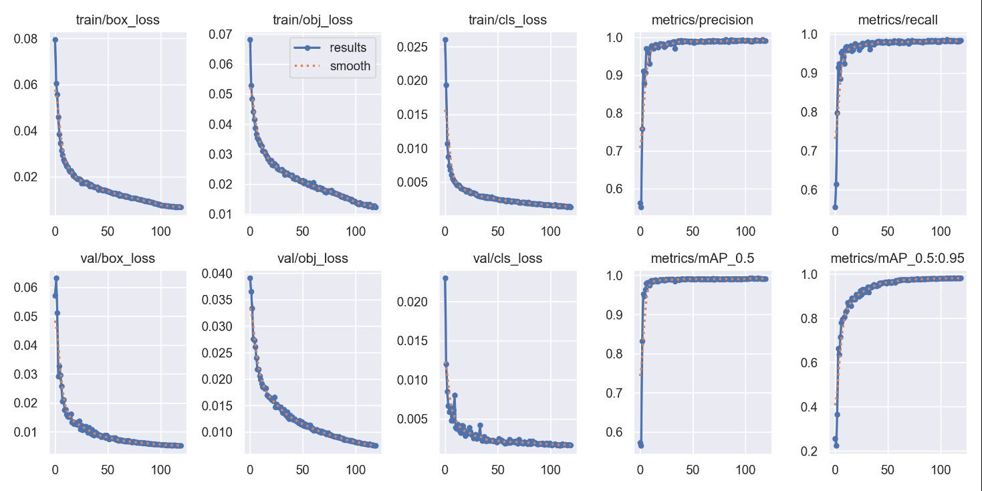
Results

Slide 8
Discoveries & Difficulties
Discoveries
Difficulties
Gained a deeper understanding of object-oriented training workflows and label-annotation techniques.
Developed stronger skills in dataset creation, augmentation, and integration.
Scarce public data: Only one freely available earthquake damage dataset on Kaggle—others are either paid or require long access delays.
Long training times: Even with an RTX 2070 and CUDA acceleration, training on ~1,250 images took over five hours, creating a significant computational bottleneck.

Slide 9
Demo

